Slide 1
Motivation & Theories of Motivation

Slide 2

Motivation
Definition :
Motivation can be defined as an inner state that activates, energizes or moves behaviour towards goal.
Motivation is the characteristic that helps you achieve your goal.
It is the drive that pushes you to work hard .It is the energy that gives you the strength to get up and keep going - even when things are not going your way.

Slide 3
Theories of Motivation

Slide 4
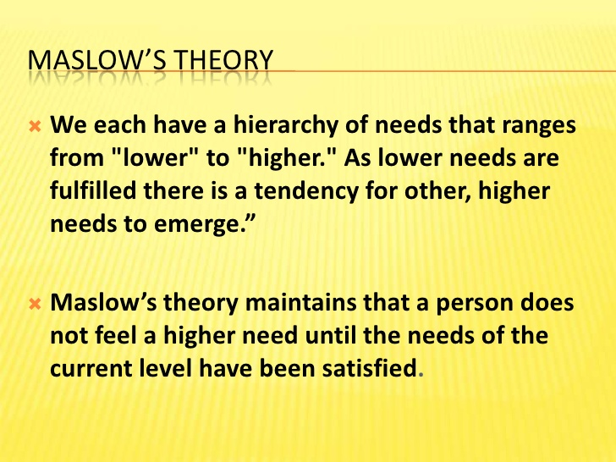

Slide 5
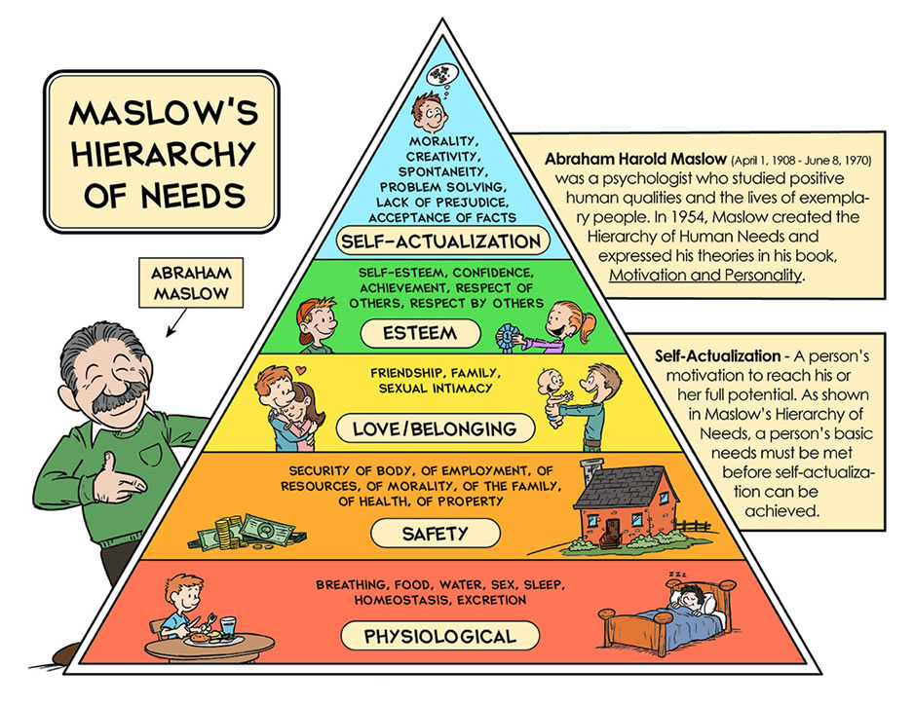

Slide 6


Slide 7
Herzberg Two Factor Theory
According to him certain characteristics tend to be consistently related to job satisfaction & others to job dissatisfaction.

Slide 8
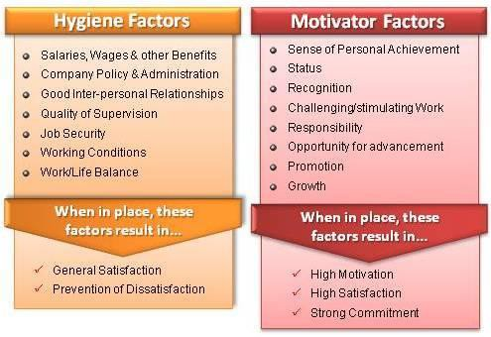
If the factors are provided then no dissatisfaction, otherwise dissatisfaction
If the factors are provided then satisfaction, otherwise no satisfaction

Slide 9
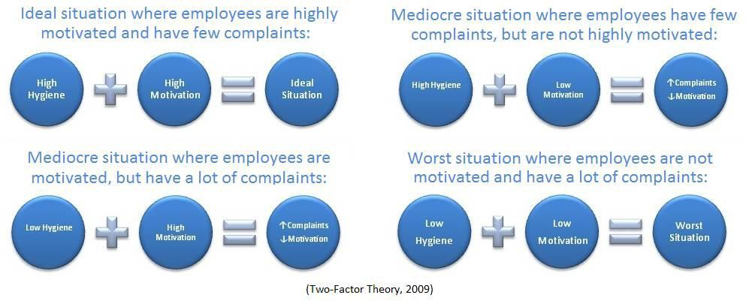

Slide 10
Theories of Motivation:
Alderfer ERG Theory
Alderfer after reworking on Maslow’s theory argued that the are three groups of core needs – existence, relatedness & growth.
Existence needs – concerned with providing our basic material requirements. They include the items of physiological and safety needs.
Relatedness needs – the desire for maintaining important interpersonal relationship. Thus includes the social need.
Growth needs – an intrinsic desire for personal development. This includes both self esteem and self actualization needs.

Slide 11
Relationship of all content theory of Motivation
Need Hierarchy
ERG
Two Factor Theory
Theory
Self Actualization
Growth
Motivation
Esteem
Relatedness
Social
Safety
Hygiene
Existence
Physiological

Slide 12
Reinforcement Theory
According to reinforcement theory, behavior is a function of its outcomes.
Reinforcement theory describes four interventions to modify employee behavior. Two of these are methods of increasing the frequency of desired behaviors, while the remaining two are methods of reducing the frequency of undesired behaviors.

Slide 13
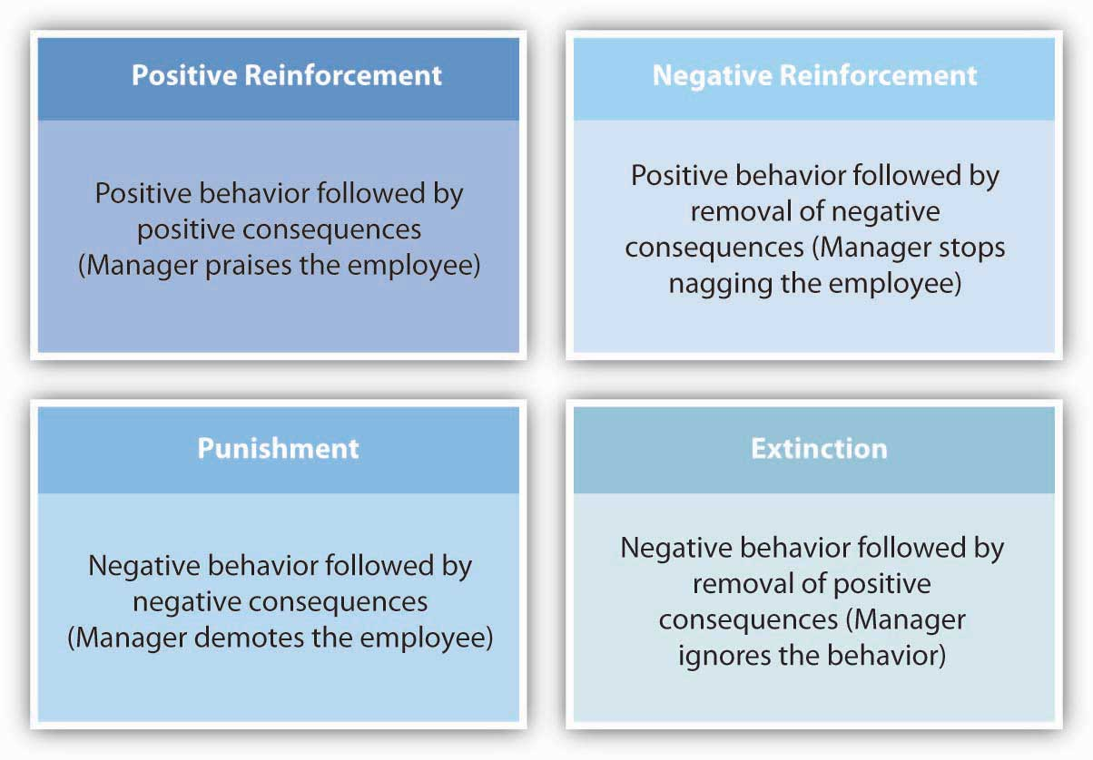
Reinforcement Theory
Reinforcement theory describes four interventions to modify employee behavior. Two of these are methods of increasing the frequency of desired behaviors, while the remaining two are methods of reducing the frequency of undesired behaviors.

Slide 14
Reinforcement Theory
Some tips to make this process more effective.
Consider whether punishment is the most effective way to modify behavior.
Be sure that the punishment fits the crime.
Be consistent in your treatment of employees.
Document the behavior in question.
Be timely with discipline.

Slide 15
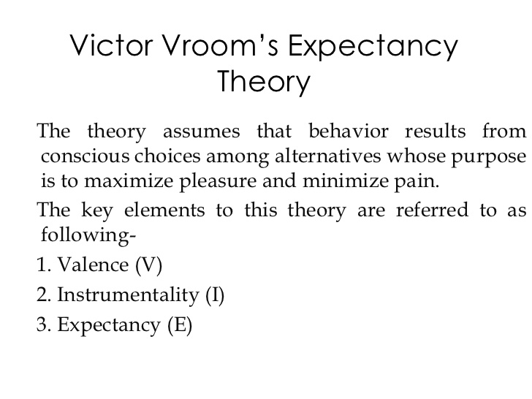
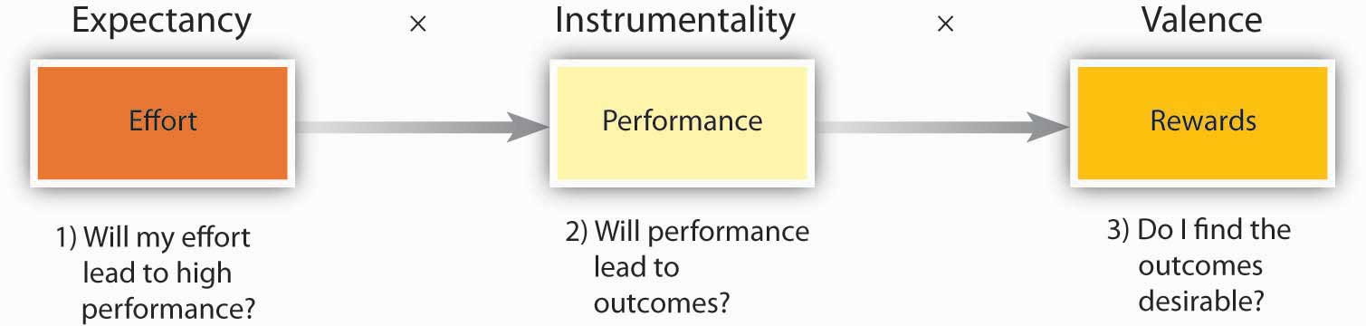
Force of motivation

Slide 16
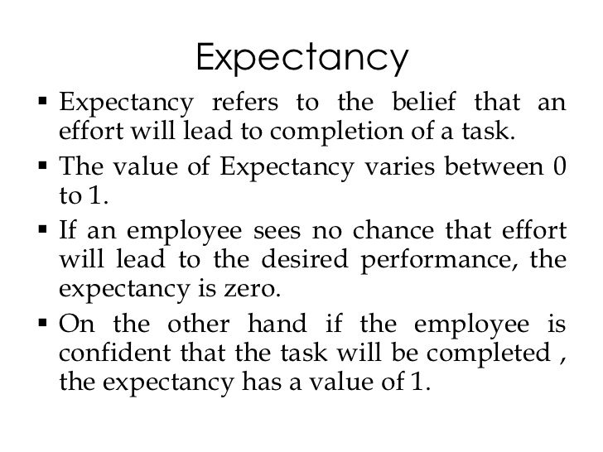

Slide 17
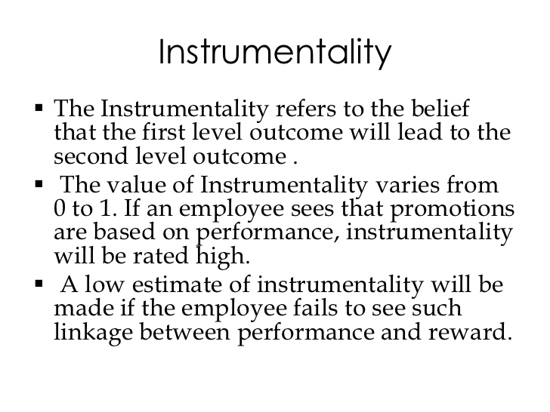

Slide 18
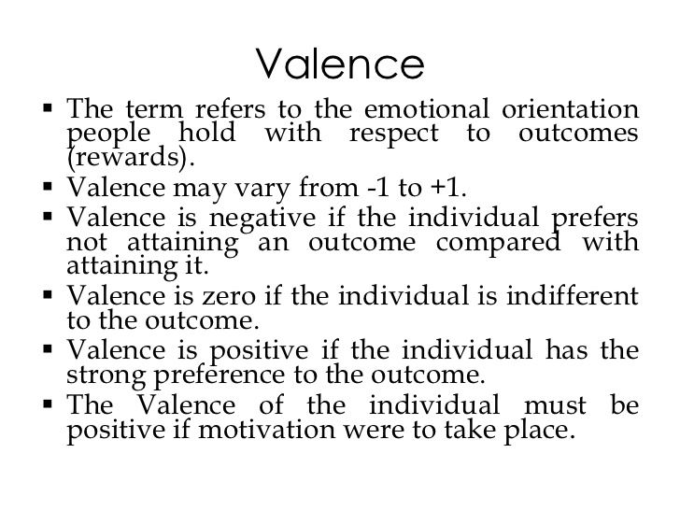

Slide 19
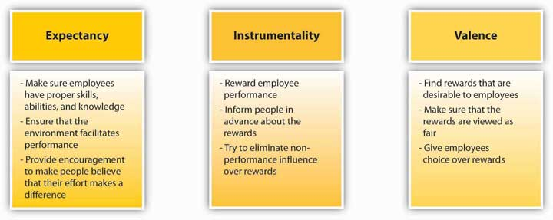
Vroom’s Expectancy Theory
Ways in Which Managers Can Influence Expectancy, Instrumentality, and Valence

Slide 20
THE END

